Slide 1
Human Following Robot
Team Members:
Mohammed Sharuk M S 1NH21EC408
Chitraravathi Mamadapur Raj 1NH21EC423
Shrinivas V 1NH21EC424

Slide 2

CONTENTS
• Introduction
• Block Diagram
• Components Required
• Cost Estimation
• Methodology
• Advantages and Disadvantages
• Application
• Conclusion
References

Slide 3
INTRODUCTION
Robotic technology has increased appreciably in past couple of years. Such innovations were only a dream for some people a couple of years back. But in this rapid moving world, now there is a need of robot such as “A Human Following Robot” that can interact and co-exist with them.
It is an High performance, high accuracy, low labour cost, ability to work in hazardous situations
Human follower robot used in industrial automation

Slide 4
COMPONENTS REQUIRED
• Microcontroller board – Arduino Uno
• Ultrasonic Sensor – HCSR04
• Motor driver
• DC Motor
• Power Supply
• Tool - Arduino IDE
• Programming languages used Embedded C/C++

Slide 5
COST ESTIMATION
Microcontroller board – Arduino Uno: 800 Ultrasonic Sensor – HCSR04: 50
IR Sensors: 2*50: 100 Motor driver: 125 DC Motor: 4*58: 228
Jumping wires: Lump sum: 40
Wheels : 4*25: 100
Batteries: 2*80: 160
Others: 100
Total Cost: 1703 Rs

Slide 6
METHODOLOGY
First, we have to build a frame or chassis as per the requirement now arrange the component in chassis as per the circuit diagram. At first place four servo motor to corner using glue. Place the Arduino and motor controller. Connect them motors. Fix the ultrasonic sensor and IR sensor. Connect the sensor to the Arduino. Input the code to the Arduino.

Slide 7
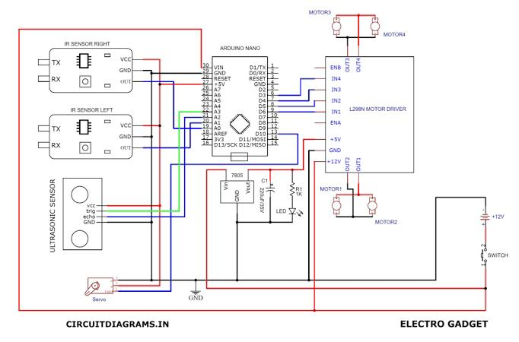
Circuit diagram

Slide 8
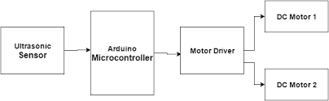
Block Diagram

Slide 9
ADVANTAGES AND DISADVANTAGES
Advantages :-
• Code compatibility and expandability across different Arduino boards
• Cost is less as Arduino is open source
• The schematic of Arduino is open source. So for future enhancement of the project the board can be extended to add more hardware features
• Ultrasonic sensor has large range and can be used in any lighting conditions
Disadvantages :-
They Lead Humans to Lose Their Jobs. … They Need Constant Power. … They’re Restricted to their Programming. … The Perform Relatively Few Tasks. …

Slide 10
APPLICATIONS
It Can assist in carrying loads for people working in airport libraries
It can serve people at shopping center by carrying goods.
It can assist elderly people ,special children
It can used as a bodyguard for humans

Slide 11
CONCLUSION
Designed human follower robot using Arduino microcontroller
It can follow a human whenever he move.
This project makes use of Arduino, an engine of different varieties of sensors to attain its aim

Slide 12
REFERENCES
From YouTube:
https://youtu.be/yAV5aZ0unag
K. Morioka, J.-H. Lee, and H. Hashimoto, “A human-based mobile robot with a distributed sensor network,” IEEE Trans. Electron., Vol. 51,nxa. 1, pp. 229-237, Feb. 2004

Slide 13


